Slide 1
Technology In Physical Therapy
By: Angely Taveras
CSIT 100-37

Slide 2

What is Physical Therapy?
Physical therapy is a method of treatment for injured or ill patients that improves their ability to move and manage pain.
Benefits of Physical Therapy include..
Pain Relief
Improvement in mobility & balance
Overall better health

Slide 3

At least more than 15% of Americans alone are in need of physical therapy.

Slide 4
Technology’s Affect
Technology has provided us with a great quantity of new improvements. Assisting healthcare providers in making the physical therapy experience more enjoyable, quicker and efficient.
Virtual Monitoring
Smart Devices
Notes:
These improvements range from simple things like virtual monitoring to smart devices that have changed the physical therapy field completely.

Slide 5
Top 3 Improvements

Slide 6
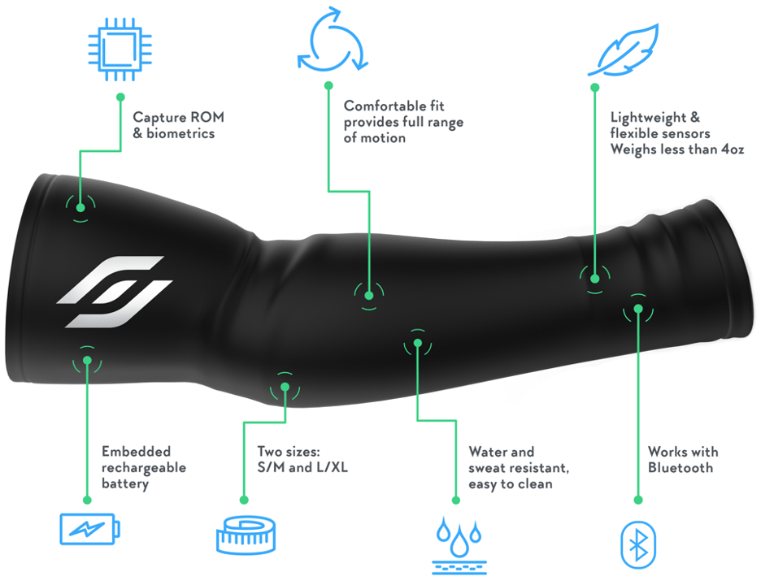
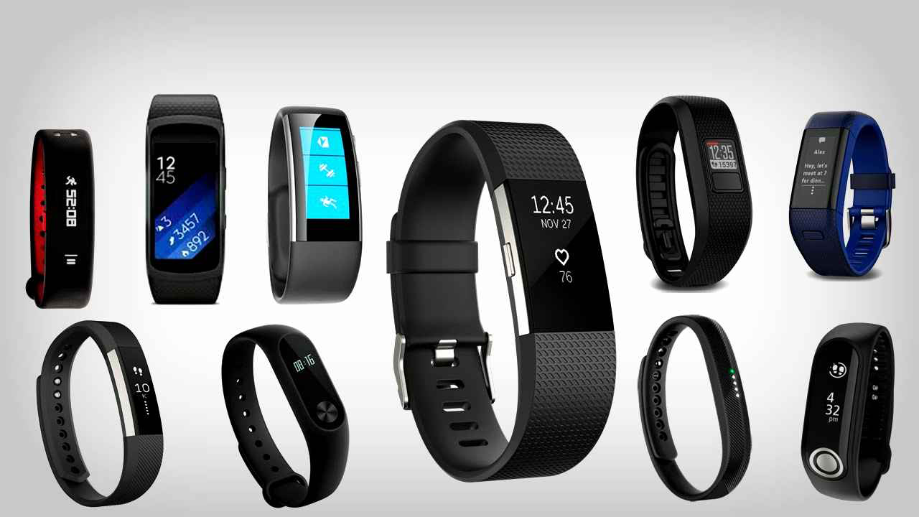

New Devices
With the use of wearable devices Physical therapists may collect patient data in real-world settings and execute their care plans remotely.
The most popular wearable devices as of right now are..
Skin Sleeves
Fitness Trackers
Fall-Sensing Technology

Slide 7
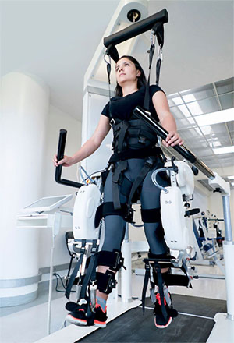
2. Robotic Physical Therapy Treatments
By 2026, the market for robotic technology in the physical therapy industry is anticipated to expand by 46%.
Working out with the help of a robotic apparatus.
Provides physical therapists with more flexibility in their motions and repetitions, which usually take longer when done manually.
Helps therapist gather information in real-time and sensory input, allowing them to customize each patients treatment

Slide 8
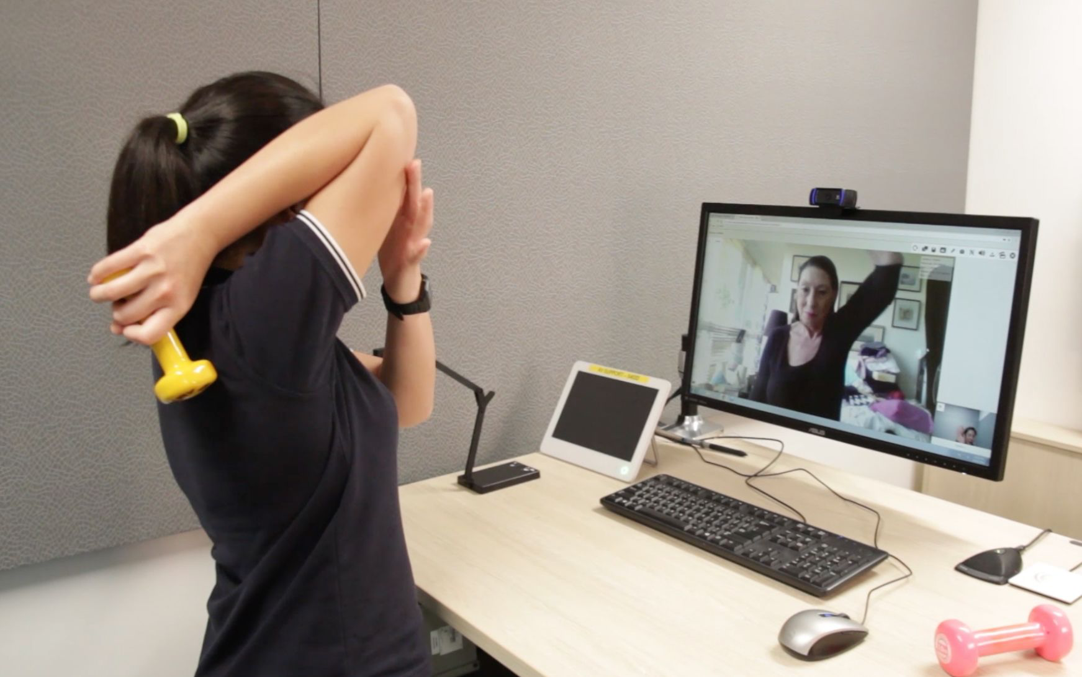
3. TeleRehabilitation
Computers have now allowed for people to get medical treatments and check ups virtually.
Provides accessibility to treatment to many people.
Makes process for patients quicker
Increases patient satisfaction and insures that patients follow their physical therapy treatment plan

Slide 9
In conclusion
Technology has improved our lives in many aspects especially in the medical field
Physical therapy is a prime example of this
Physical therapy is something a great majority of people utilize at least once in their lives
With technology we can improve that experience

Slide 10
Work Cited
Diena, Yitz. “74 Physical Therapy Statistics, Facts & Demographics.” At-Home ABA Therapy For Autism - Ambitions ABA, Ambitions ABA, 31 Aug. 2023, www.ambitionsaba.com/resources/physical-therapy-statistics#:~:text=Top%2010%20Physical%20Therapy%20Statistics&text=Over%2050%20million%20Americans%20seek,reduction%20in%20pain%20after%20treatment.
“7 Ways Technology Is Changing Physical Therapy.” University of the Cumberlands, 15 Nov. 2023, www.ucumberlands.edu/blog/technology-is-changing-physical-therapy.

